Slide 1
Microsoft Azure
Azure Data Factory

Slide 2
Lesson Objectives
Understand where ADF fits in Cortana Analytics
Understand how ADF Works, and its components
Be able to deploy and manage a simple ADF implementation
Transformation of Data BLOB to BLOB
Transformation of Data SQL to BLOB
Transformation of Data SQL DB to Azure Data Lake
Transformation of Data BLOB to SQL DB

Slide 3
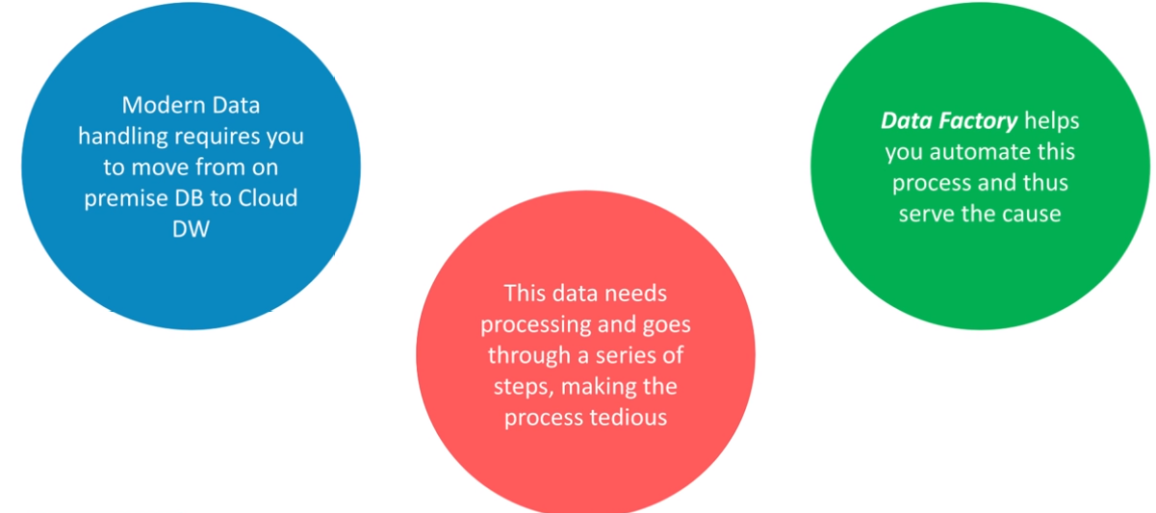
Why Data Factory?

Slide 4
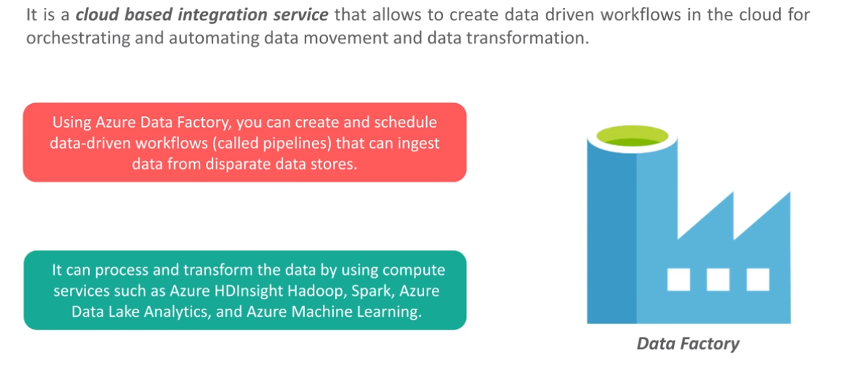
Azure Data Factory

Slide 5
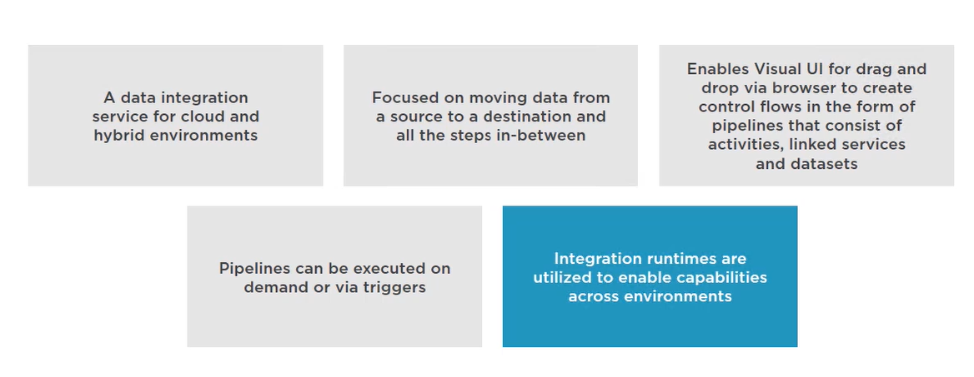
Azure Data Factory

Slide 6
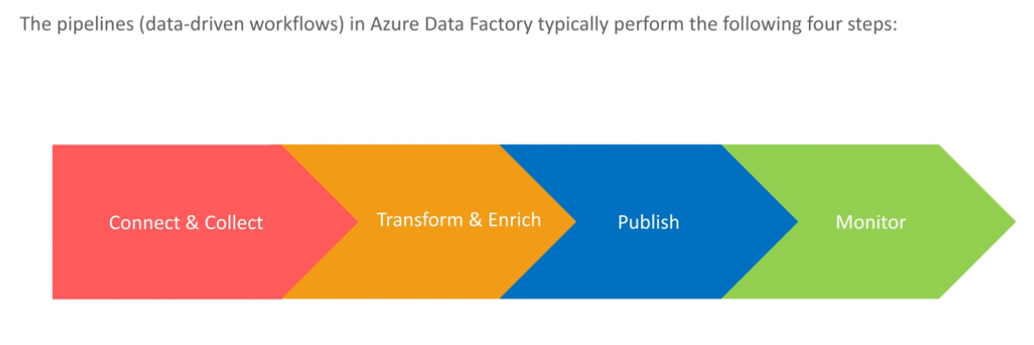
How Does it Work?

Slide 7







Operationalized Analytic Solutions
Information Management
Big Data Stores
Machine Learning and Analytics
Dashboards and Visualizations
Business apps
Azure
Storage
Power BI
Azure
Machine Learning
Personal Digital Assistant
Azure
Data Factory
Azure
Data Lake
Cortana
People
Custom apps
Azure
HDInsight (Hadoop)
Perceptual Intelligence
Azure
Data Catalog
Azure
SQL Data Warehouse
Face, vision
Speech, text
Azure
Stream Analytics
Business Scenarios
Sensors and devices
Azure
Event Hub
Recommendations,
customer churn,
forecasting, etc.
Automated Systems
DATA
INTELLIGENCE
ACTION
Notes:
Cortana Analytics Suite delivers an end-to-end platform with integrated and comprehensive set of tools and services to help you build intelligent applications that let you easily take advantage of Advanced Analytics.
First Cortana Analytics Suite provides services to bring data in, so that you can analyze it. It provides information management capabilities like Azure Data Factory so that you can pull data from any source (relational DB like SQL or non-relational ones like your Hadoop cluster) in an automated and scheduled way, while performing the necessary data transforms (like setting certain data columns as dates vs. currency etc). Think ETL (Extract, Transform, Load) in the cloud. Event hub does the same for IoT type ingestion of data that streams in from lots of end points.
The data brought in then can be persisted in flexible big data storage services like Data Lake and Azure SQL DW.
You can then use a wide range of analytics services from Azure ML to Azure HDInsight to Azure Stream Analytics to analyze the data that are stored in the big data storage. This means you can create analytics services and models specific to your business need (say real time demand forecasting).
The resultant analytics services and models created by taking these steps can then be surfaced as interactive dashboards and visualizations via Power BI
These same analytics services and models created can also be integrated into various different UI (web apps or mobile apps or rich client apps) as well as via integrations with Cortana, so end users can naturally interact with them via speech etc., and so that end users can get proactively be notified by Cortana if the analytics model finds a new anomaly (unusual growth in certain product purchases- in the case of real time demand forecasting example given above) or whatever deserves the attention of the business users.

Slide 8
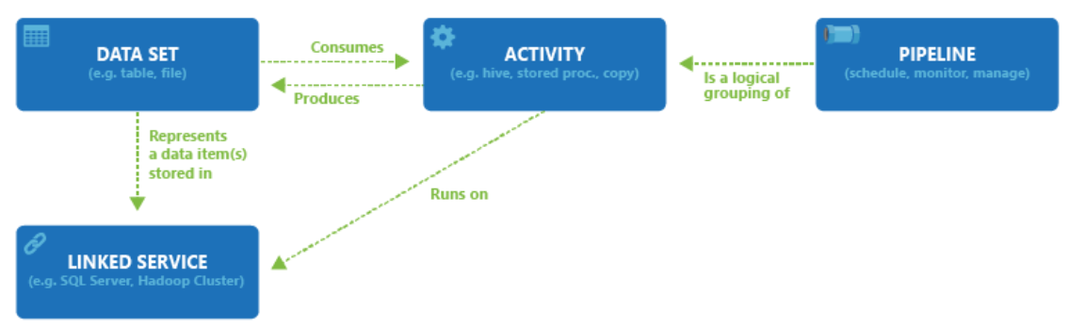
Azure Data Factory- What we can do using ADF?
& ADF Components
ADF use to manage data movement (ETL) and enrichment through the cloud and on premises.
The following diagram shows the relationships among pipeline, activity, dataset, and linked service in Data Factory:

Slide 9
Datasets in ADF
A dataset is a named view of data that simply points or references the data you want to use in your activities as inputs and outputs.
Datasets identify data within different data stores, such as tables, files, folders, and documents.
For example, an Azure Blob dataset specifies the blob container and folder in Blob storage from which the activity should read the data.
Before you create a dataset, you must create a linked service to link your data store to the data factory.
Dataset type:
Azure Blob Storage, Azure Data Lake Store , Azure SQL DB, Azure Database for MySQL, All Azure Storage, On premises Databases and Files like Amazon S3 file system, FTP etc
For more details explore:
https://docs.microsoft.com/en-us/azure/data-factory/concepts-datasets-linked-services

Slide 10
Dataset Options in ADF
Source | Sink
Blob | Blob, Table, SQL Database, SQL Data Warehouse, OnPrem SQL Server, SQL Server on IaaS, DocumentDB, OnPrem File System, Data Lake Store
Table | Blob, Table, SQL Database, SQL Data Warehouse, OnPrem SQL Server, SQL Server on IaaS, DocumentDB, Data Lake Store
SQL Database | Blob, Table, SQL Database, SQL Data Warehouse, OnPrem SQL Server, SQL Server on IaaS, DocumentDB, Data Lake Store
SQL Data Warehouse | Blob, Table, SQL Database, SQL Data Warehouse, OnPrem SQL Server, SQL Server on IaaS, DocumentDB, Data Lake Store
DocumentDB | Blob, Table, SQL Database, SQL Data Warehouse, Data Lake Store
Data Lake Store | Blob, Table, SQL Database, SQL Data Warehouse, OnPrem SQL Server, SQL Server on IaaS, DocumentDB, OnPrem File System, Data Lake Store
SQL Server on IaaS | Blob, Table, SQL Database, SQL Data Warehouse, OnPrem SQL Server, SQL Server on IaaS, Data Lake Store
OnPrem File System | Blob, Table, SQL Database, SQL Data Warehouse, OnPrem SQL Server, SQL Server on IaaS, OnPrem File System, Data Lake Store
OnPrem SQL Server | Blob, Table, SQL Database, SQL Data Warehouse, OnPrem SQL Server, SQL Server on IaaS, Data Lake Store
OnPrem Oracle Database | Blob, Table, SQL Database, SQL Data Warehouse, OnPrem SQL Server, SQL Server on IaaS, Data Lake Store
OnPrem MySQL Database | Blob, Table, SQL Database, SQL Data Warehouse, OnPrem SQL Server, SQL Server on IaaS, Data Lake Store
OnPrem DB2 Database | Blob, Table, SQL Database, SQL Data Warehouse, OnPrem SQL Server, SQL Server on IaaS, Data Lake Store
OnPrem Teradata Database | Blob, Table, SQL Database, SQL Data Warehouse, OnPrem SQL Server, SQL Server on IaaS, Data Lake Store
OnPrem Sybase Database | Blob, Table, SQL Database, SQL Data Warehouse, OnPrem SQL Server, SQL Server on IaaS, Data Lake Store
OnPrem PostgreSQL Database | Blob, Table, SQL Database, SQL Data Warehouse, OnPrem SQL Server, SQL Server on IaaS, Data Lake Store
Notes:
Data Movement requirements: https://azure.microsoft.com/en-us/documentation/articles/data-factory-data-movement-activities/
From on-premises, requires Data Management Gateway: https://azure.microsoft.com/en-us/documentation/articles/data-factory-move-data-between-onprem-and-cloud/

Slide 11
Linked Services in ADF
Before you create a dataset, you must create a linked service to link your data store to the data factory.
Linked services are much like connection strings, which define the connection information needed for Data Factory to connect to external resources.
Think of it this way; the dataset represents the structure of the data within the linked data stores, and the linked service defines the connection to the data source.
For example, an Azure Storage linked service links a storage account to the data factory.
An Azure Blob dataset represents the blob container and the folder within that Azure storage account that contains the input blobs to be processed.
For more details explore:
https://docs.microsoft.com/en-us/azure/data-factory/concepts-datasets-linked-services
https://docs.microsoft.com/en-us/rest/api/datafactory/linkedservices/get

Slide 12
Sample Scenario on Datasets and Linked Service of ADF
Sample scenario:
To copy data from Blob storage to a SQL database, you create two linked services: Azure Storage and Azure SQL Database.
Then, create two datasets: Azure Blob dataset (which refers to the Azure Storage linked service) and Azure SQL Table dataset (which refers to the Azure SQL Database linked service).
The Azure Storage and Azure SQL Database linked services contain connection strings that Data Factory uses at runtime to connect to your Azure Storage and Azure SQL Database, respectively.
The Azure Blob dataset specifies the blob container and blob folder that contains the input blobs in your Blob storage.
The Azure SQL Table dataset specifies the SQL table in your SQL database to which the data is to be copied.

Slide 13
Activity & Pipeline in ADF
A data factory can have one or more pipelines. A pipeline is a logical grouping of activities that together perform a task.
For example, a pipeline could contain a set of activities that ingest and clean log data, and then kick of a Spark job on an HDInsight cluster to analyse the log data.
The beauty of this is that the pipeline allows you to manage the activities as a set instead of each one individually.
For example, you can deploy and schedule the pipeline, instead of the activities independently.
The activities in a pipeline define actions to perform on your data.
For example:- you may use a copy activity to copy data from an on-premises SQL Server to an Azure Blob Storage. Then, use a Hive activity that runs a Hive script on an Azure HDInsight cluster to process/transform data from the blob storage to produce output data. Finally, use a second copy activity to copy the output data to an Azure SQL Data Warehouse on top of which business intelligence (BI) reporting solutions are built.

Slide 14
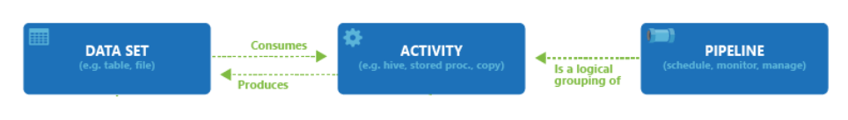
Activity & Pipeline in ADF Con…
Data Factory supports three types of activities:
Data movement activities : Copy Activity in Azure Data Factory
https://docs.microsoft.com/en-us/azure/data-factory/copy-activity-overview
Data transformation activities : Transform data in Azure Data Factory
https://docs.microsoft.com/en-us/azure/data-factory/transform-data
Control activities : Web activity in Azure Data Factory
https://docs.microsoft.com/en-us/azure/data-factory/control-flow-web-activity
An activity can take zero or more input datasets and produce one or more output datasets.
The following diagram shows the relationship between pipeline, activity, and dataset in Data Factory:

Slide 15
Activity Options in ADF
Transformation activity | Compute environment
Hive | HDInsight [Hadoop]
Pig | HDInsight [Hadoop]
MapReduce | HDInsight [Hadoop]
Hadoop Streaming | HDInsight [Hadoop]
Machine Learning activities: Batch Execution and Update Resource | Azure VM
Stored Procedure | Azure SQL
Data Lake Analytics U-SQL | Azure Data Lake Analytics
DotNet | HDInsight [Hadoop] or Azure Batch
Notes:
Main Document Sites: https://azure.microsoft.com/en-us/documentation/articles/data-factory-data-transformation-activities/

Slide 16
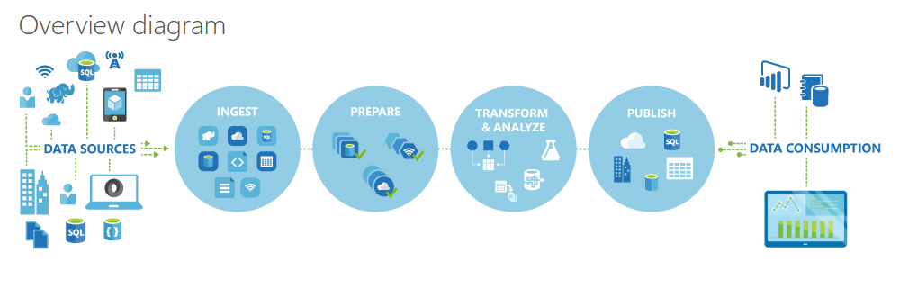
ADF Logical Flow
In Azure Data Factory, you can use Copy Activity to copy data among data stores located on-premises and in the cloud.
After the data is copied, it can be further transformed and analyzed. You can also use Copy Activity to publish transformation and analysis results for business intelligence (BI) and application consumption.

Slide 17
ADF Process
Define Architecture: Set up objectives and flow
Create the Data Factory: Portal, PowerShell, VS
Create Linked Services: Connections to Data and Services
Create Datasets: Input and Output
Create Pipeline: Define Activities
Monitor and Manage: Portal or PowerShell, Alerts and Metrics

Slide 18






1. Design Process - Use case of Churning in Telcom Industries
Define data sources, processing requirements, and output – also management and monitoring
Azure Data
Factory:
Data Set
(Collection of files, DB table, etc)
Activity: a processing step
(Hadoop job, custom code, ML model, etc)
Pipeline: a logical group of activities
Data Sources
Ingest
Transform & Analyze
Publish
Call Log Files
Call Log Files
Transform, Combine, etc
Analyze
Move
Act (Visualize)
Customer Table
Customer Table
On Premises
Data Mart
Customer Call Details
Customers Likely to Churn
Customer Churn Table
Azure Blob Storage
Azure DB
Notes:
https://azure.microsoft.com/en-us/documentation/articles/data-factory-customer-profiling-usecase/
Video of this process: https://azure.microsoft.com/en-us/documentation/videos/azure-data-factory-102-analyzing-complex-churn-models-with-azure-data-factory/

Slide 19
End to End Source to Target ADF Demo Blob to Blob Using ADF SQL DB to Blob using ADF Blob to ADL using ADF
Notes:
Main Dataset Document Site: https://azure.microsoft.com/en-us/documentation/articles/data-factory-create-datasets/

Slide 20
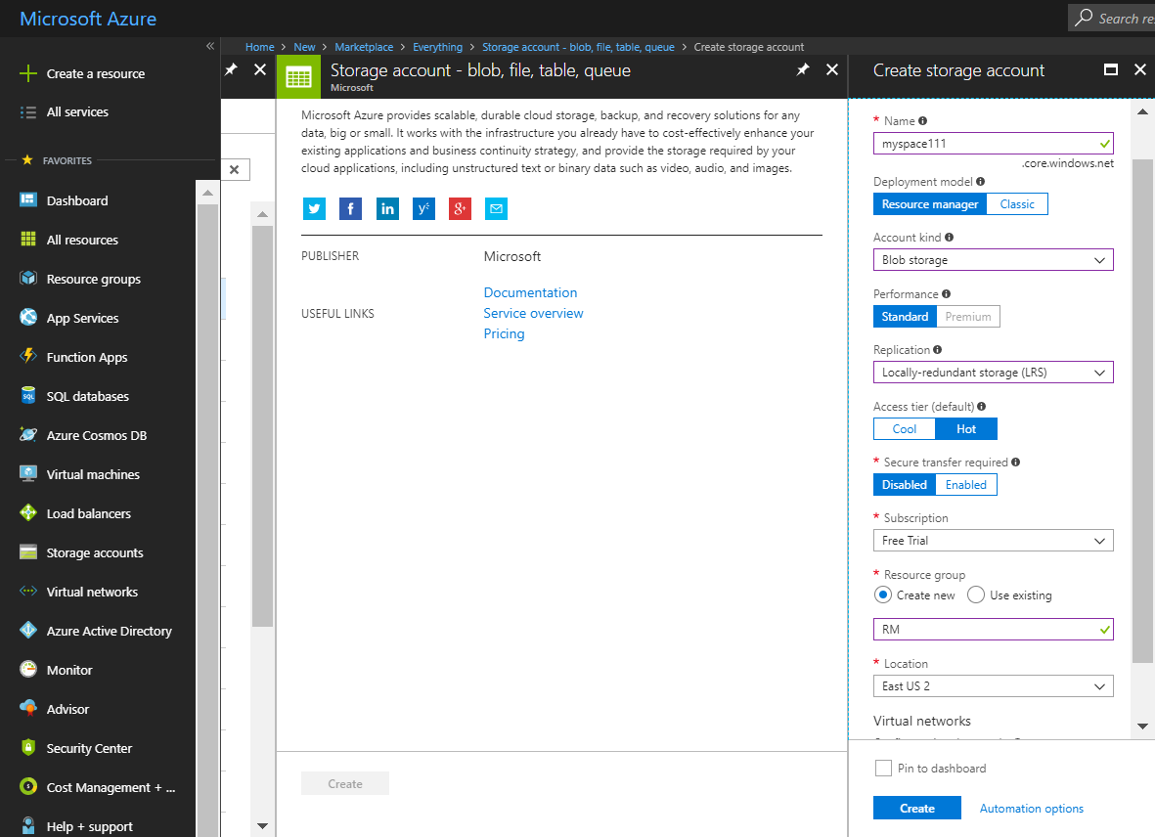
Blob to Blob Copying data using Data Factory
Deploy Blob Storage Account ➔ Go To Storage Account ➔ Blob Account
1
2

Slide 21
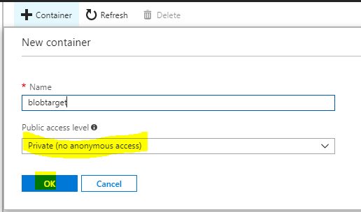
Create Container for Source and Target
Create container ➔ Source and Target ➔ load a file into source.
1
2
3
4

Slide 22
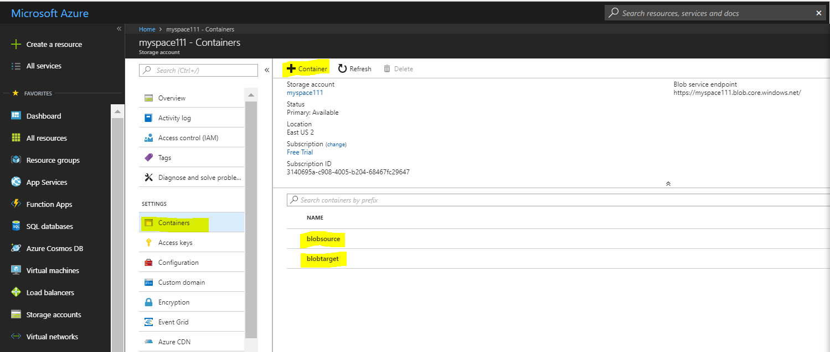
Create Container for Source and Target Con…
You can see Created Container here

Slide 23
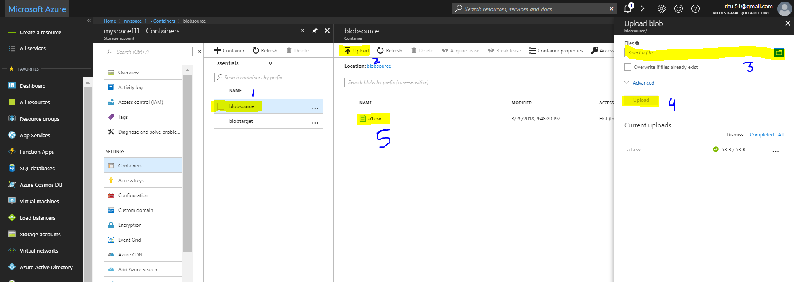
Load Data to Source Container
Select file ➔ a1.csv ➔ Load
2
3
1
4
5

Slide 24
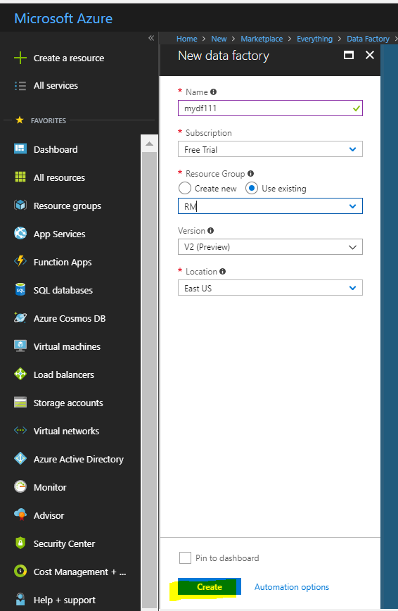
Deploy Data Factory
Go To ➔ Create Resource ➔Select Data factory ➔ Fill all Details
1.Give ADF Name
2. Select Resource Group OR Create
3. Select Version
4. Select Location
5. Create

Slide 25
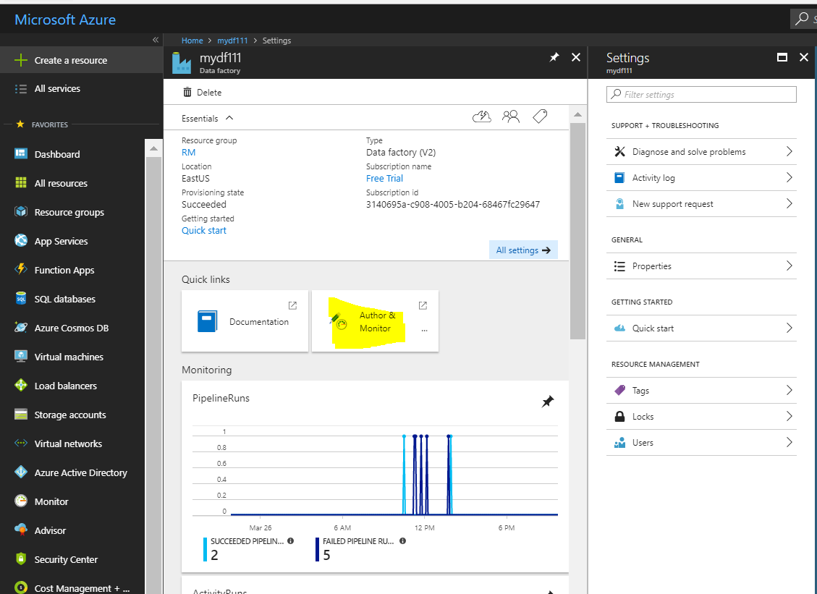
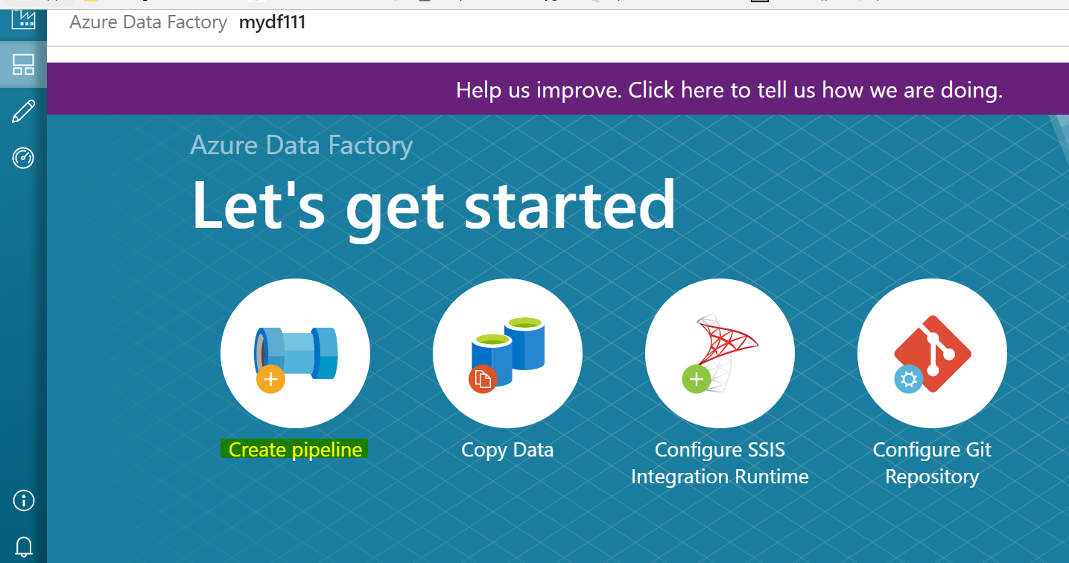
Open Author and Monitor
Go To ➔ Author and Monitor
1
2

Slide 26
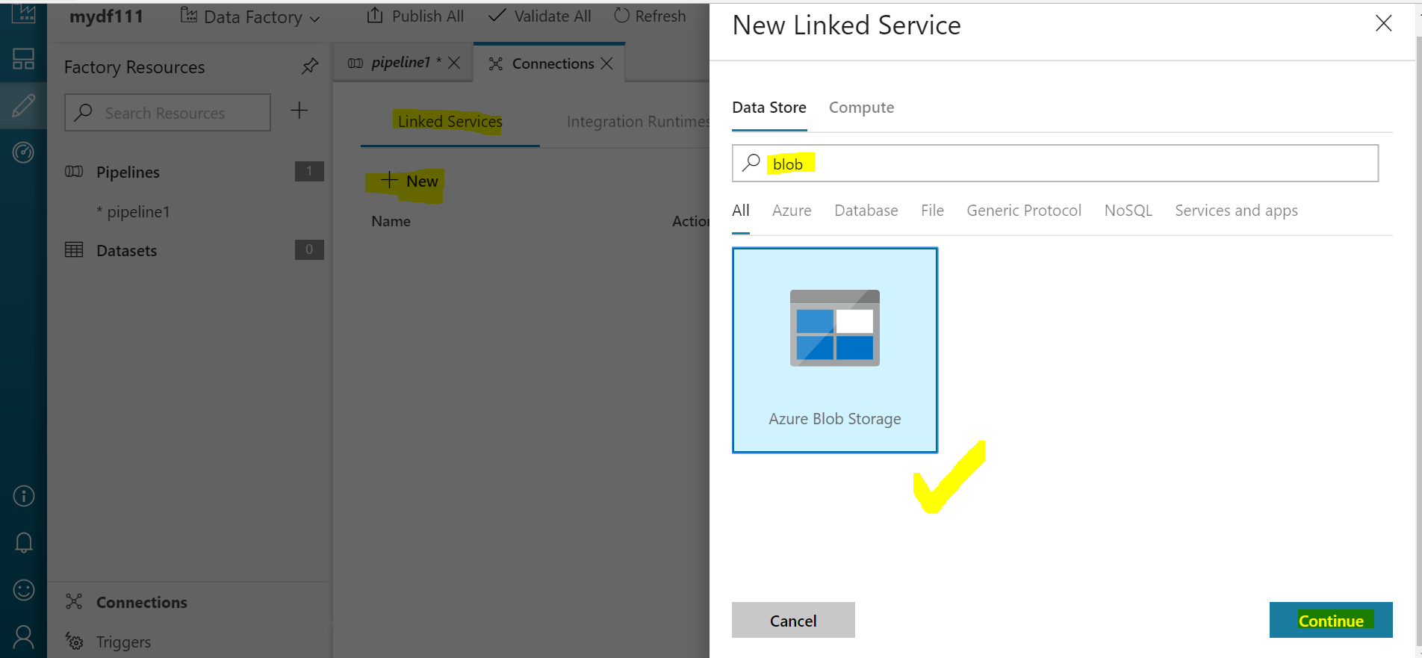
Create Linked Service
Create linked services in a data factory to link your data stores and compute services to the data factory. Here you don't use any compute service such as Azure HDInsight or Azure Data Lake Analytics. You use two data stores of type Azure Storage Blob as source & destination.
Go To Connection ➔ Create linked Service ➔ Click on +New ➔ Add whatever you want to link with Data factory in this case its Blob Storage.
4
5
7
6
8
3
9

Slide 27
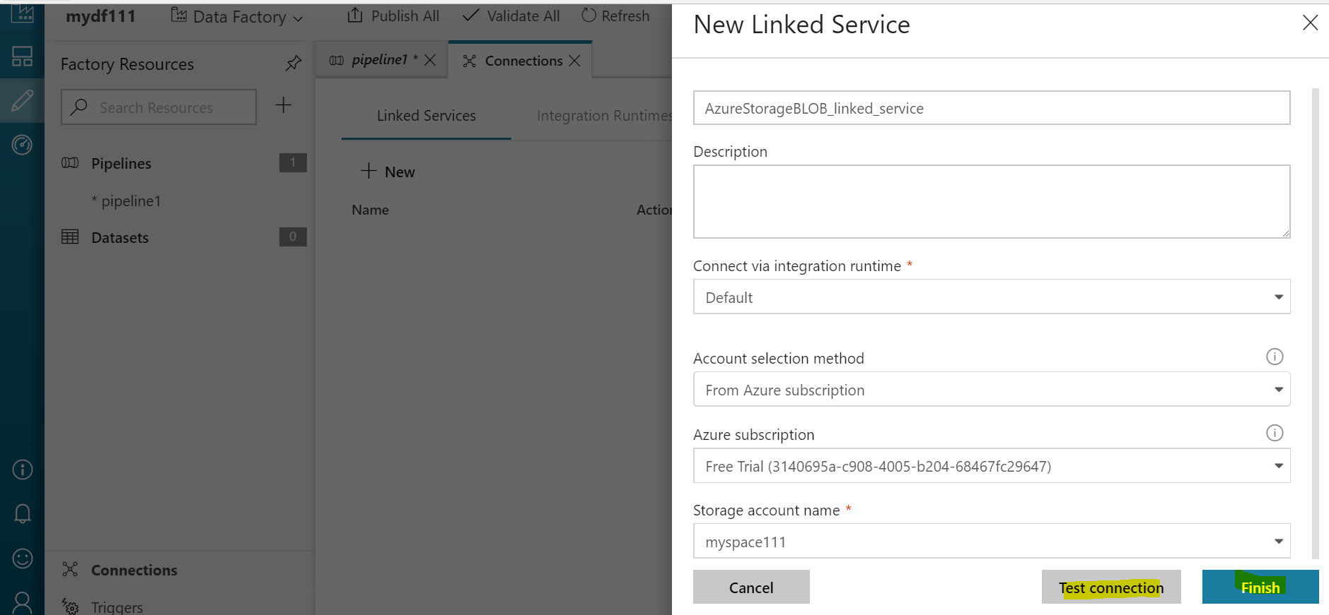
Create Linked Service Con…
After Clicking on Continue ➔ Give all required Credentials ➔ Test Connection ➔ Finish
10
11
12
13
14
15

Slide 28
Create Data Sets
In the previous step, you created linked services to link your Azure Storage account to your data factory.
In this step, you define two datasets named AzureBlobSource and AzureBlobTarget that represent input and output data that is stored in the data stores referred by AzureStorageLinkedService.
The Azure storage linked service specifies the connection string that Data Factory service uses at run time to connect to your Azure storage account.
And, the input blob dataset (AzureBlobSource) specifies the container and the folder that contains the input data.

Slide 29
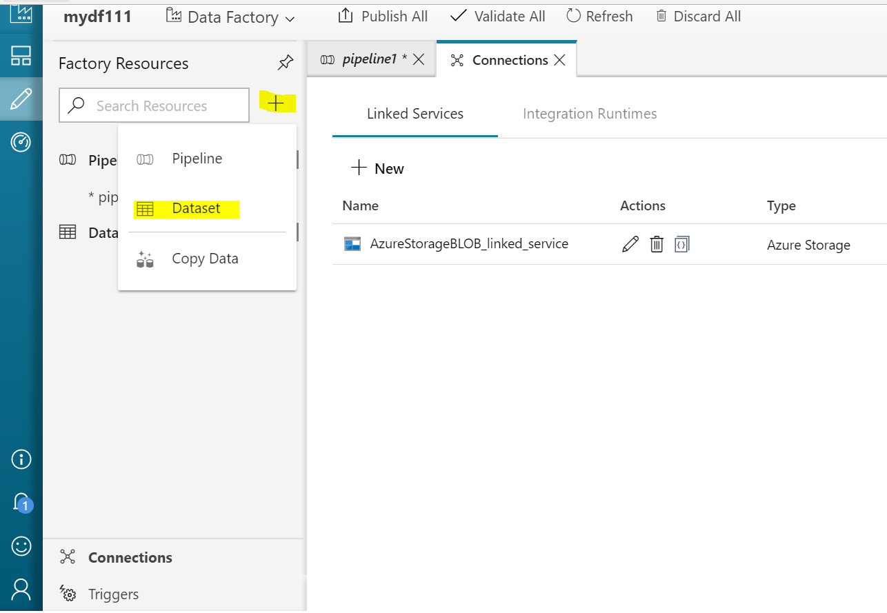
Create Data Sets Con…
Create Data Set ➔ Go To + Sign ➔ Choose Data Set ➔ Add Azure Blob Data Set ➔ Finish
1
2

Slide 30
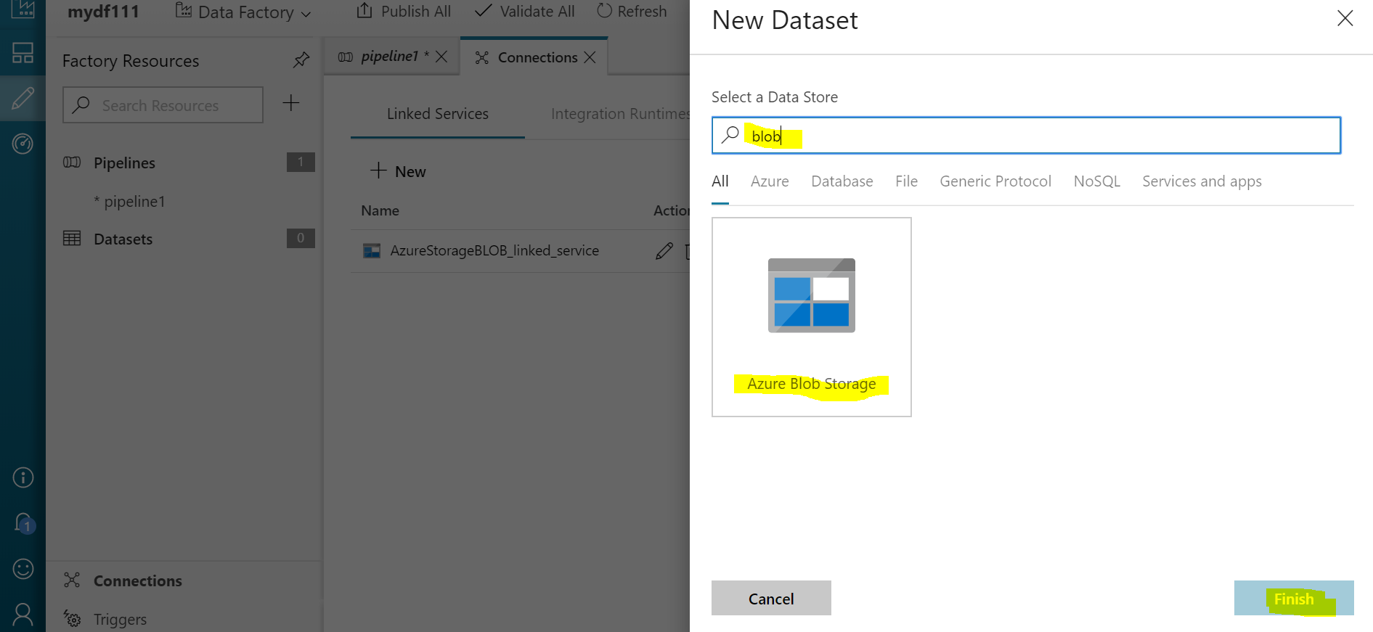
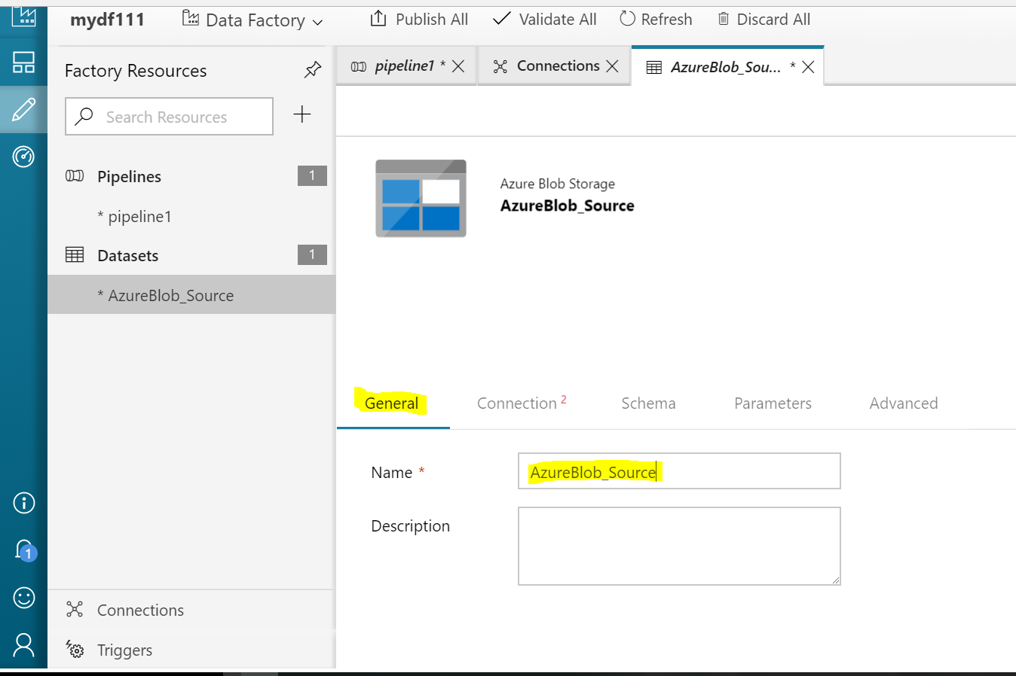
Create Data Sets Con…
3
4
6
5

Slide 31
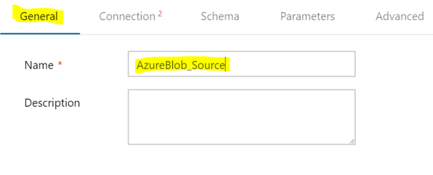
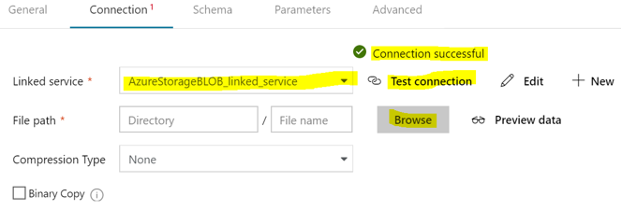
Create Data Sets Con…
Go To General ➔ Enter Name you want to Give here (AzureBlob_Source)
Go To Connection ➔ Give Respective Linked Service Name ➔ Test Connection ➔ Give file Path which is stored in Blob Storage ➔ finish
8
9
7
10

Slide 32
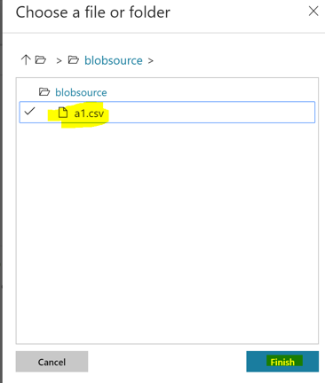
Create Data Sets Con…
Browse file ➔ Finish
11
12

Slide 33
Create Data Set for Target
Create Data Set ➔ Go To + Sign ➔ Choose Data Set ➔ Add Azure Blob Data Set ➔ Finish
1
2

Slide 34
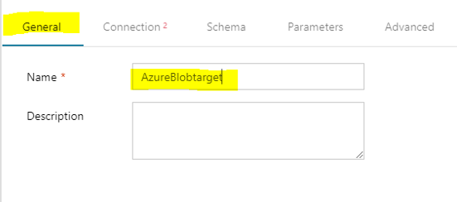
Create Data Set for Target Con…
6
3
7
4
5

Slide 35
Create Data Set for Target Con…
Go To General ➔ Enter Name you want to Give here (AzureBlob_Target)
Go To Connection ➔ Give Respective Linked Service Name ➔ Test Connection ➔ Give file Path where you want to store file i.e AzureBlob_target ➔ finish
6
8
9
7
10

Slide 36
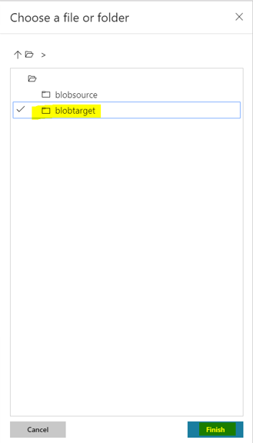
Create Data Set for Target Con…
Browse file ➔ Give path of folder ➔ Finish
11
12

Slide 37
Create Pipeline
you create a pipeline with a copy activity that uses AzureBlob_Source as an input and AzureBlob_target as an output.
Go To + Sign ➔ Pipeline
1
2

Slide 38
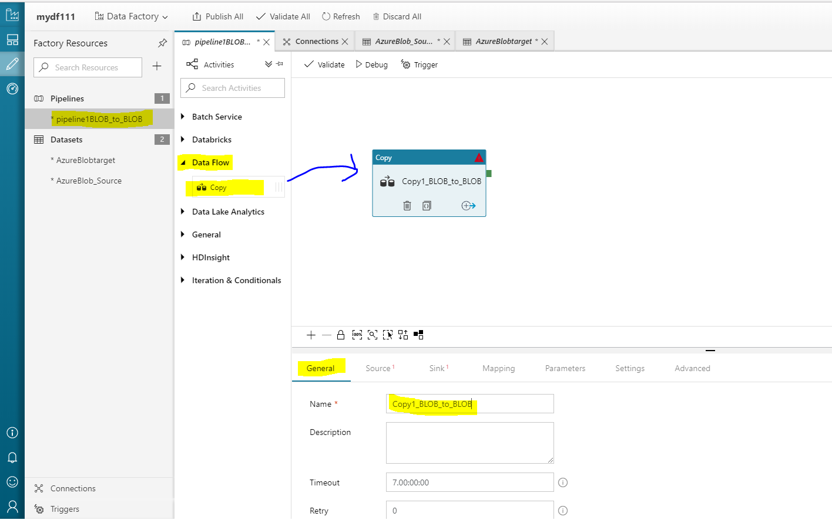
Create Pipeline Con…
Give Name to Pipe Line ➔ Data Flow ➔ Select Copy ➔ Drag and Drop ➔ Give Information like ➔ General
3
4
6
5
7
8

Slide 39
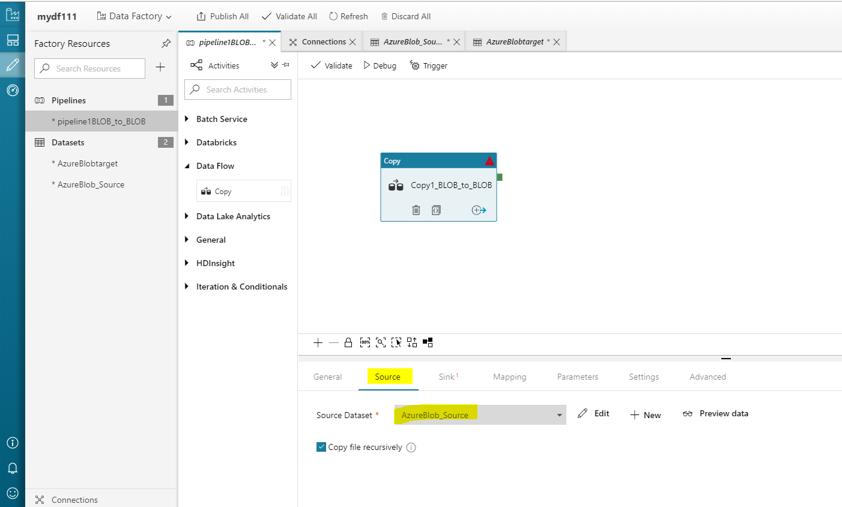
Create Pipeline Con…
Give ➔ Source information ➔ Source Data set Name
9
10

Slide 40
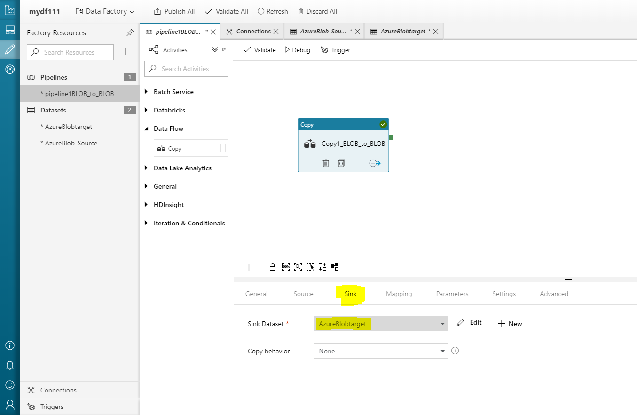
Create Pipeline Con…
Give ➔ Sink information ➔ Target Data set Name
11
12

Slide 41
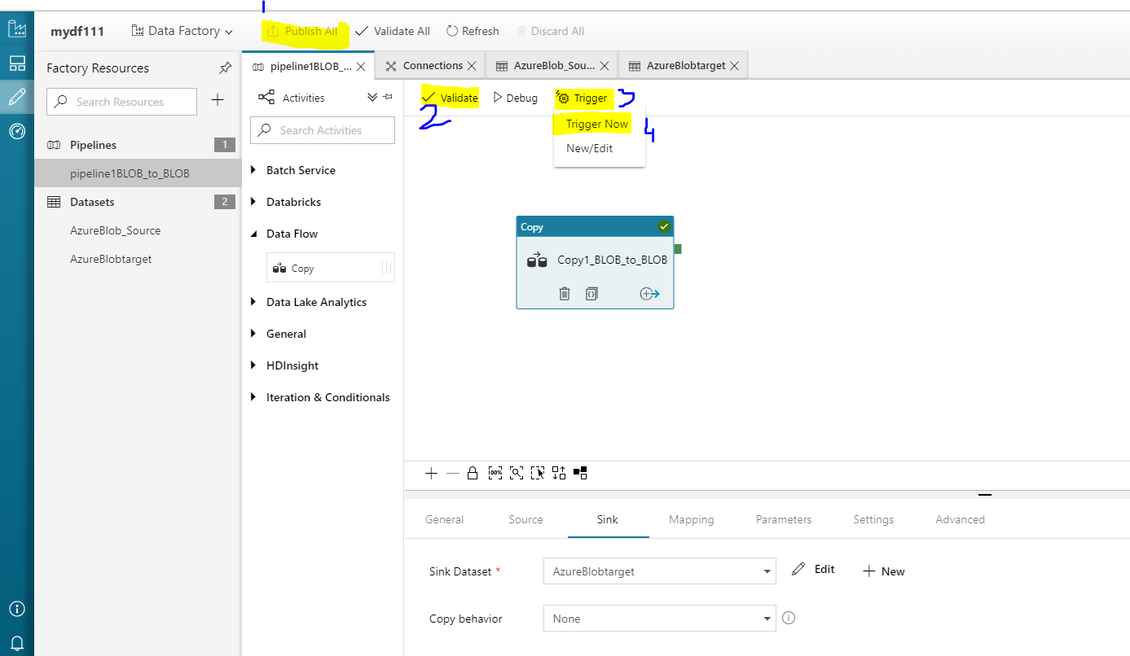
Execute Pipeline
Click on Publish All ➔ validate ➔ Triger ➔ Triger Now ➔ Click on Finish
13
14
15
16

Slide 42
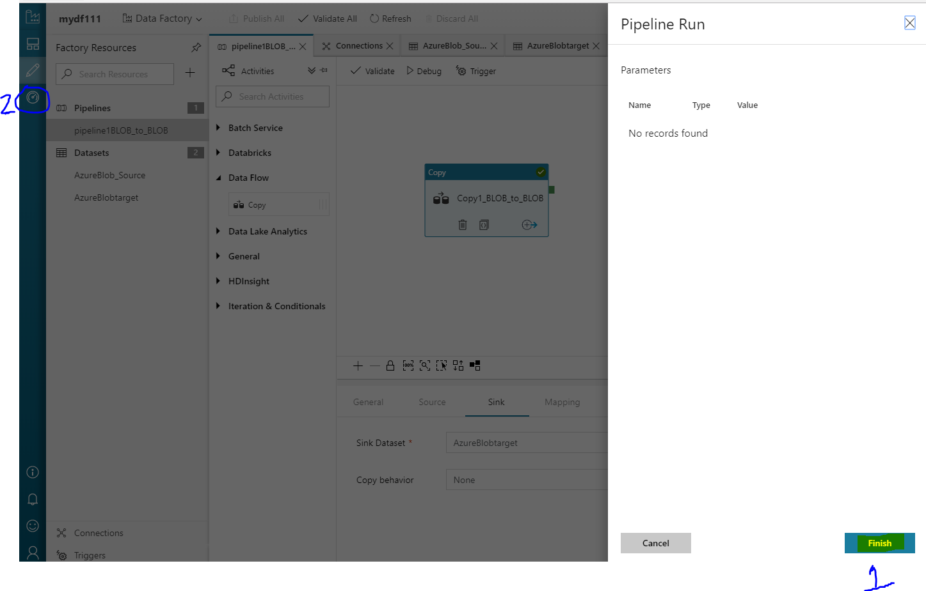
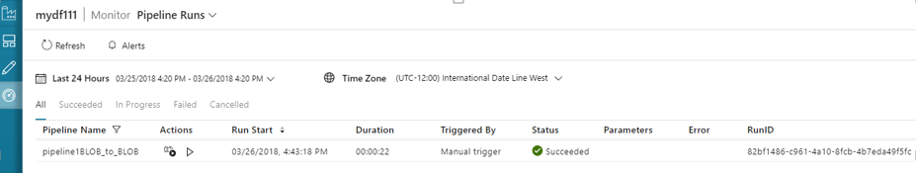
Execute Pipeline +
Click on Finish ➔ To see Report click on Left 2nd Option
18
17

Slide 43
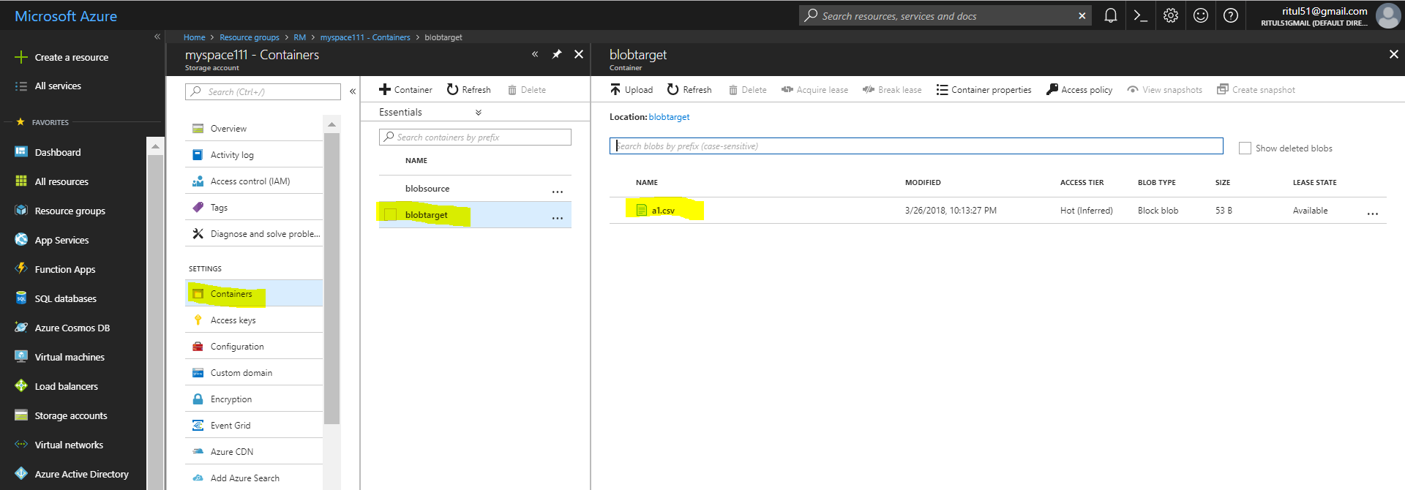
Check data in BLOB target folder
Go To Storage Account ➔ Container ➔ Folder ➔ check Data
3
4
2
1

Slide 44
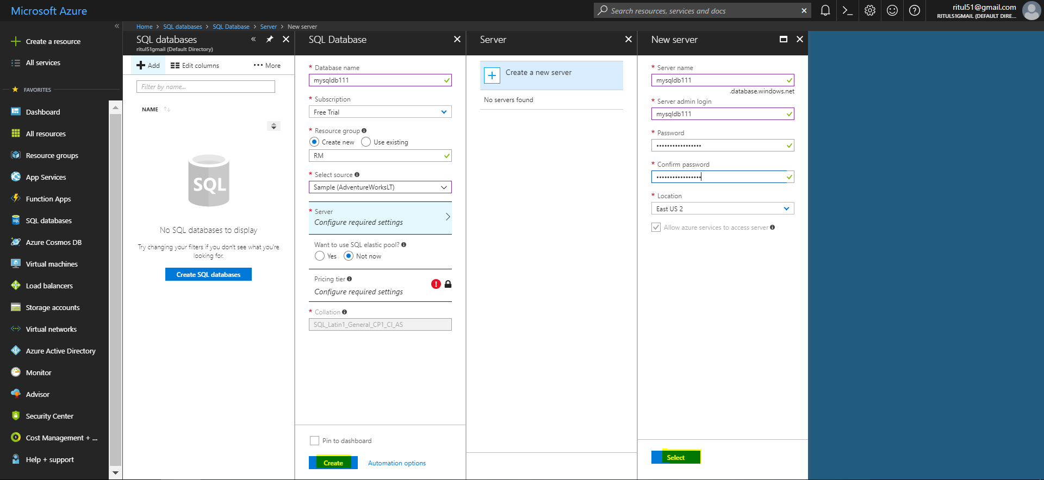
SQL DB to BLOB using ADF
3. Create SQL Server
Go To portal ➔ Select SQL DB ➔Deploy SQL DB ➔ Give Credentials
1. Deploy SQL DB
2. SQL DB ask for Server
4. Select Resource as per price(Next Slide)

Slide 45
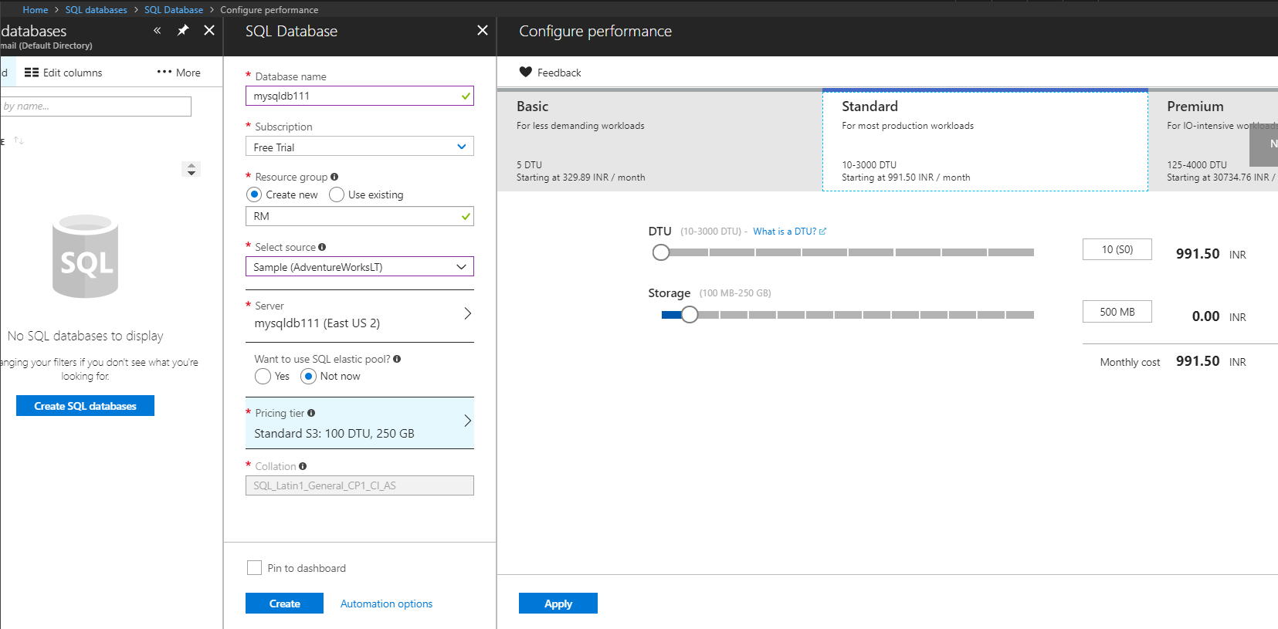
Deploy SQL DB Con…
1
2
3
5
4

Slide 46
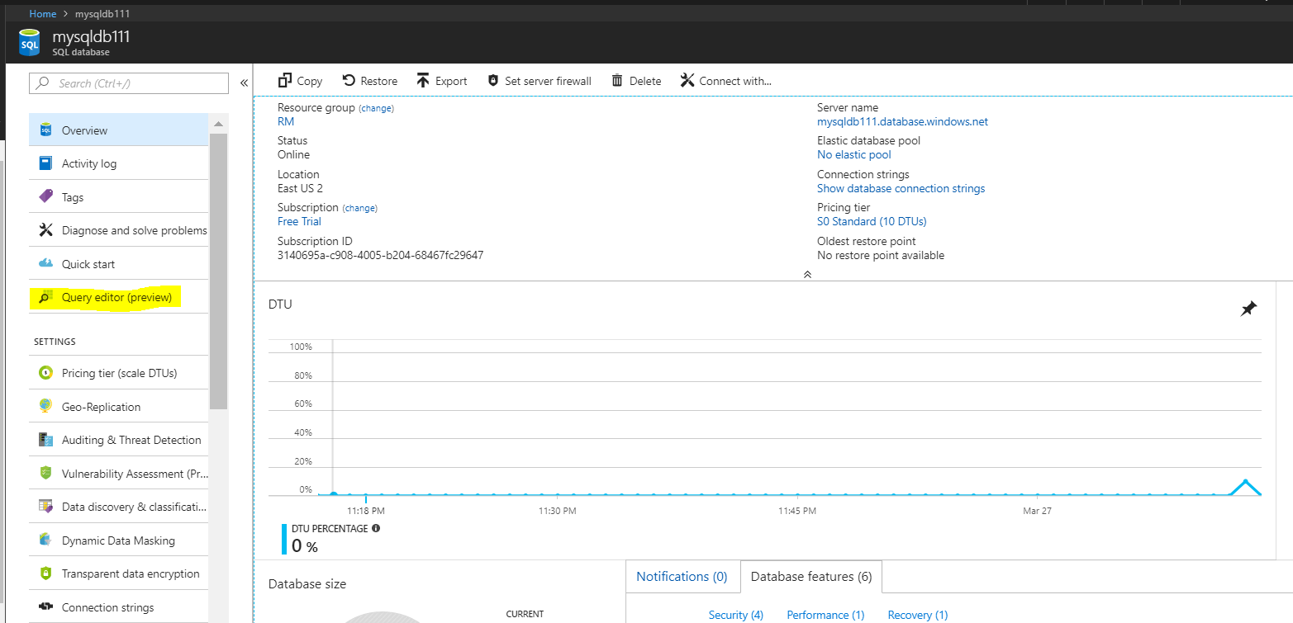
Open Query Editor in deployed SQL DB
Open query editor to write Query

Slide 47
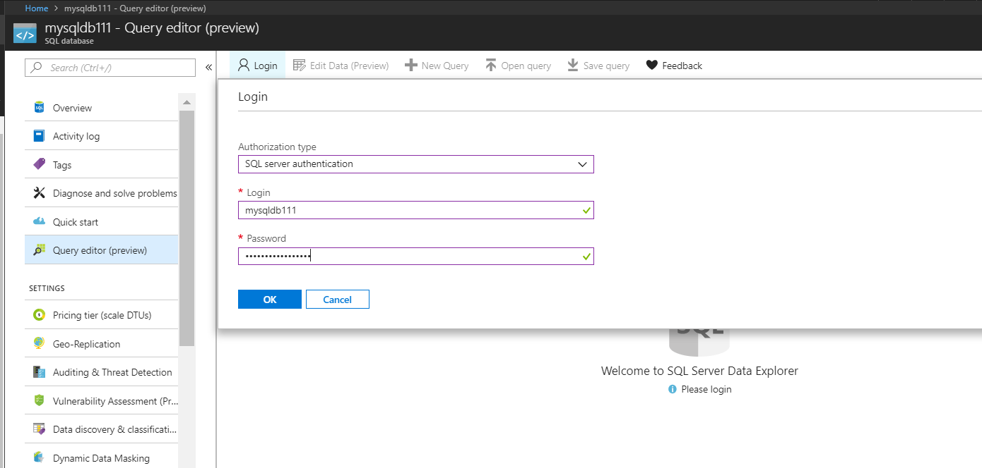
Login to SQL DB
Give SQL DB credentials to login to SQL DB➔ Which is just created in previous step
1
2
Give Credentials of SQL Server Previously Created

Slide 48
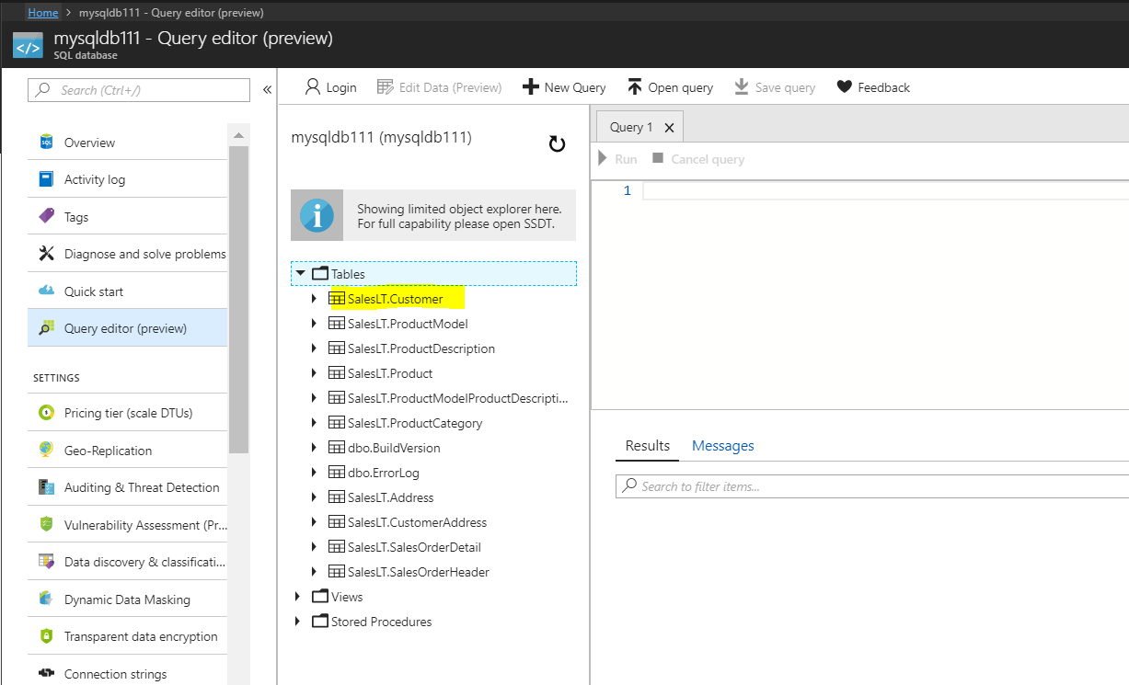
Sample Database SalesLT.Customers

Slide 49
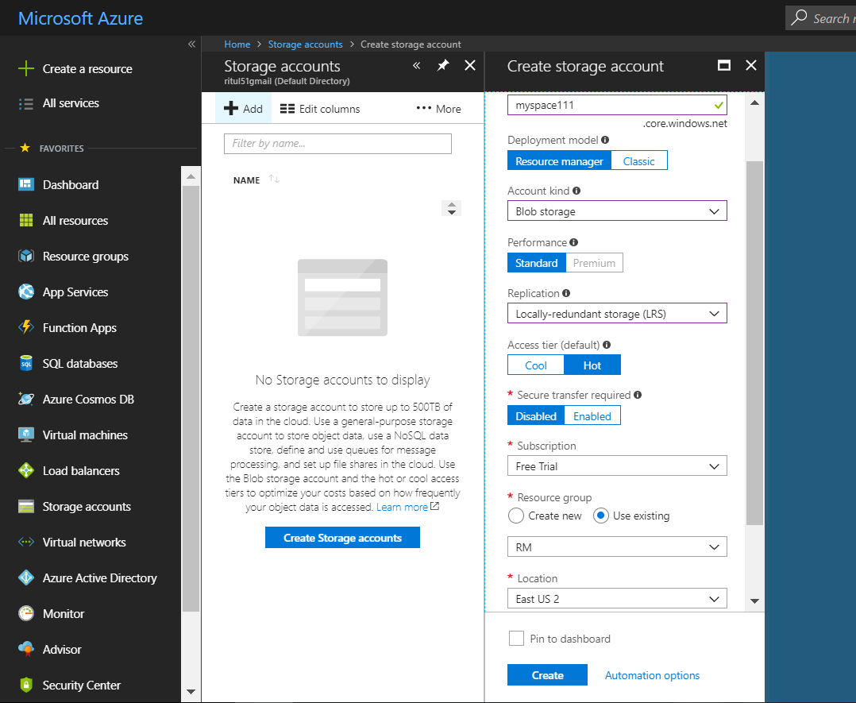
Deploy Blob & Create target container
Create Blob Storage ➔ Create target Container where you are going to load data

Slide 50
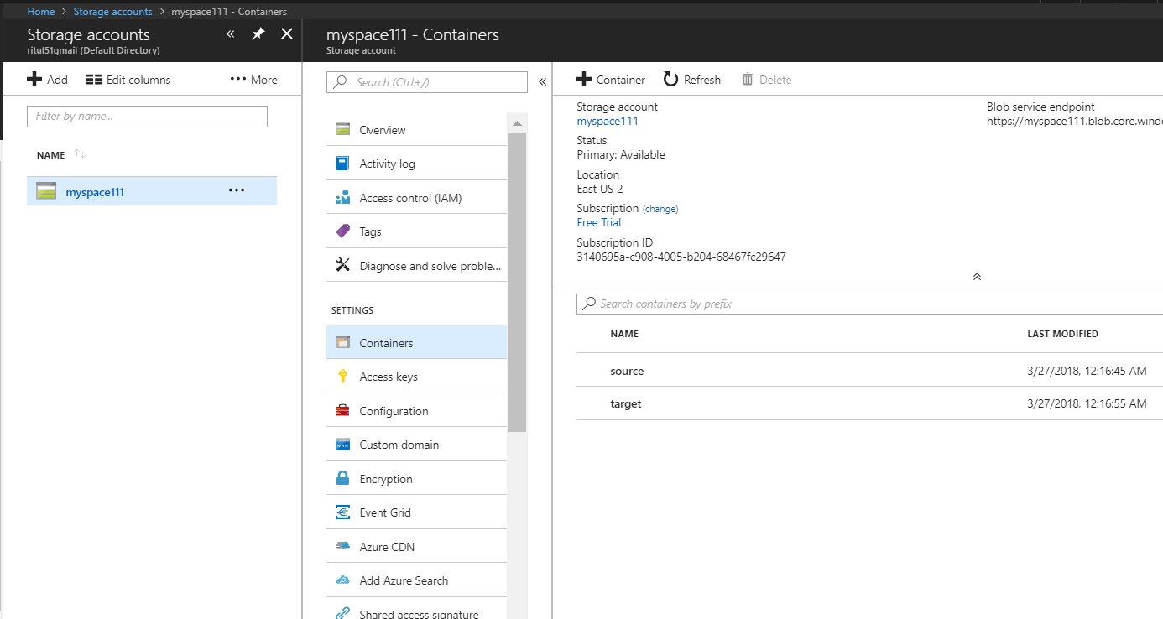
Deploy Blob & Create target container Con…
Create Container ➔ Target

Slide 51
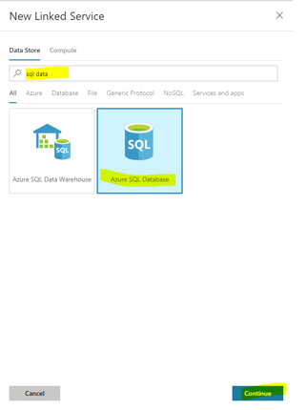
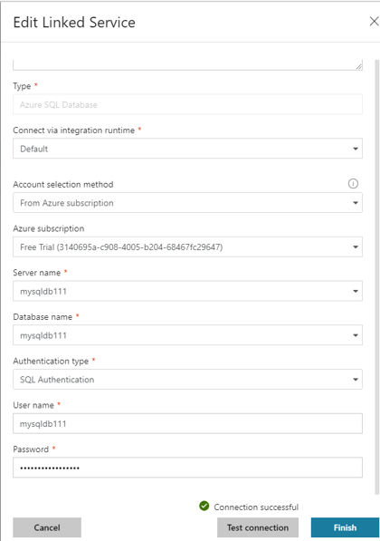
Deploy Data factory & Create Linked Service
Deploy Data Factory ➔ Go to Author and Monitor ➔ Create pipeline ➔ Create Linked Service
Need to create different-2 linked service to connect with SQL DB and BLOB storage.
Go To Connection ➔ Create linked Service ➔ Click on +New ➔ Add whatever you want to link with Data factory in this case its SQL DB & Blob Storage .

Slide 52
Linked service for Blob Storage
Create Linked service for Blob Storage as same as you created in previous example.

Slide 53
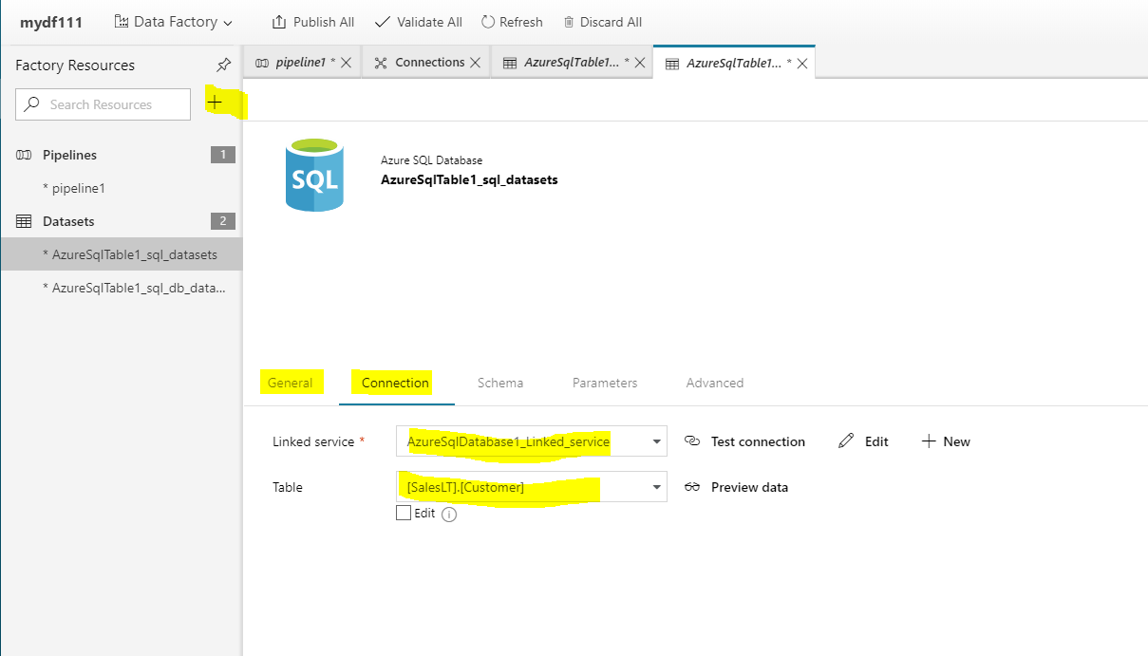
Create Dataset for SQL DB
General ➔ Give name to dataset
Connection ➔ Give respective Linked service & Select Database table which data you want in Blob

Slide 54
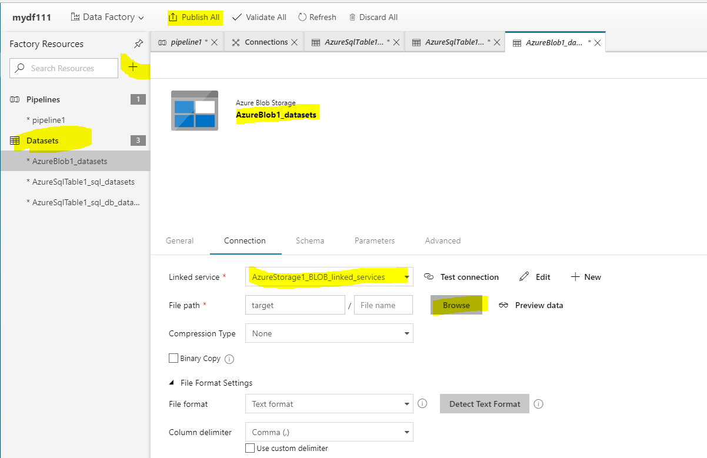
Create Dataset for BLOB
General ➔ Give name to dataset
Connection ➔ Give respective Linked service & Select Target where you want to load data

Slide 55
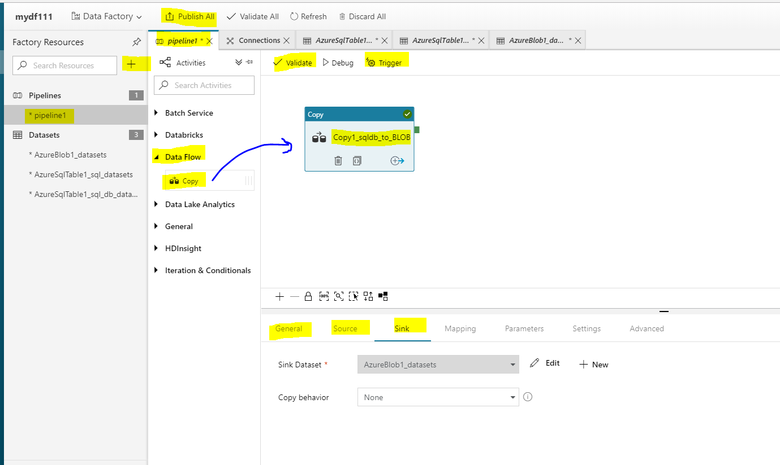
Create Pipeline and Triger
Go To + Sign ➔ Pipeline ➔ Data Flow ➔ Drag and Drop COPY ➔ Set Source and Sink Information ➔ Publish All ➔ Validate ➔ Triger ➔ Triger Now ➔ finish

Slide 56
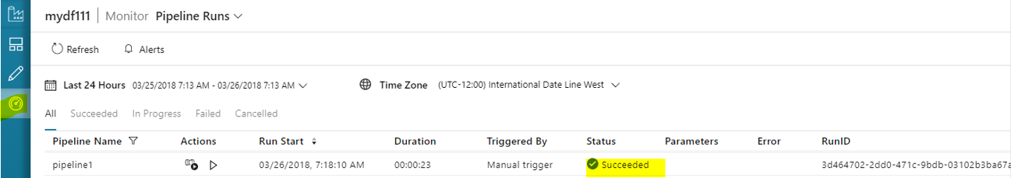
Pipeline Report

Slide 57
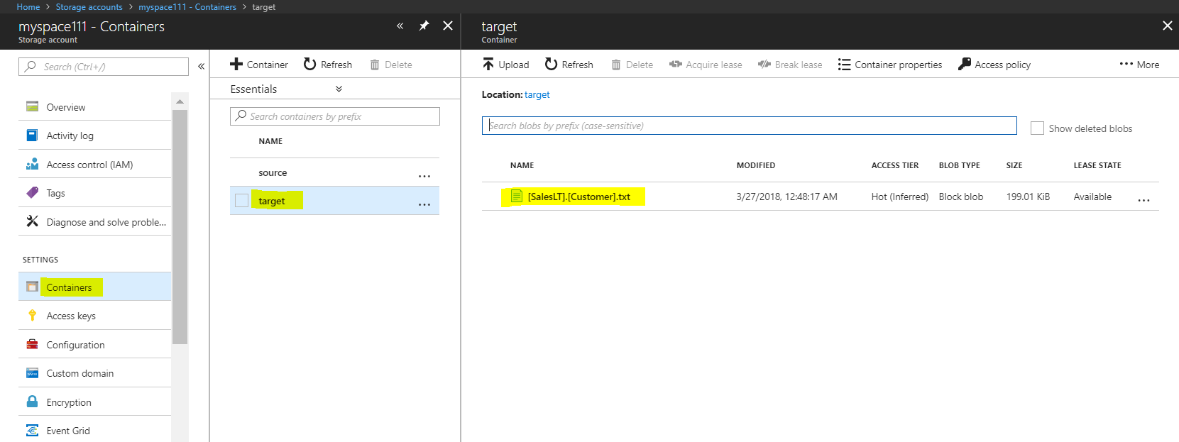
Check target container in BLOB Storage

Slide 58
SQL DB (MS Azure) to Data Lake using ADF
Deploy SQL DB
Deploy Data Lake
Deploy Data factory

Slide 59
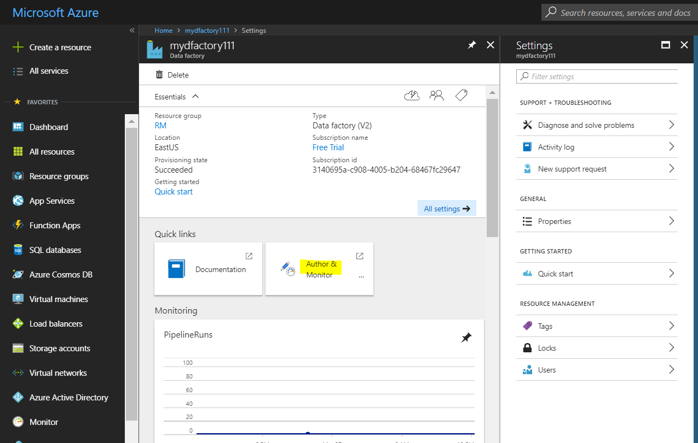
Azure Data Factory
Now SQL DB, ADL and Data factory is ready.
Open Data factory ➔ Author and monitor ➔ Create pipeline

Slide 60
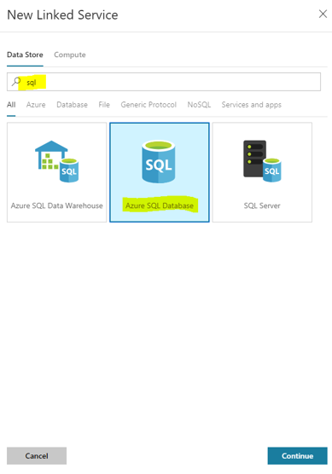
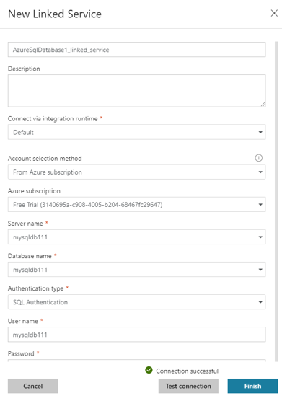
Create Linked Service for SQL DB
Go To Connection ➔ Create linked Service ➔ Click on +New ➔ Add whatever you want to link with Data factory in this case its SQL DB & Azure Data lake .

Slide 61
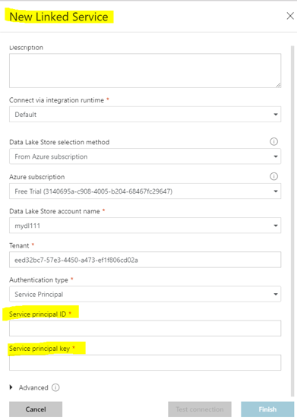
Create Linked Service for Azure Data lake
New linked Service for Data Lake: Asking for subscription ID and key

Slide 62
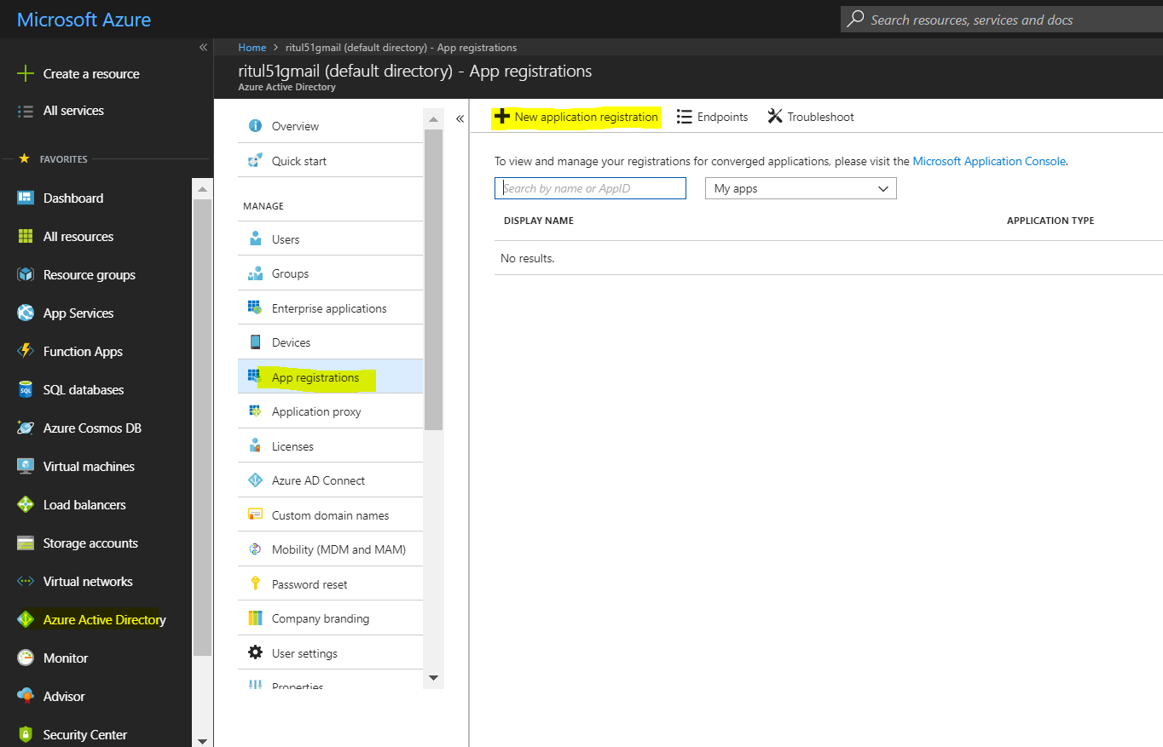
Get ID and KEY
To get those ID and keys GO TO Azure Active Directory and create NEW APP Registration, do register this app with Data Lake and then enter credentials to above linked service.
Go To Azure Active Directory ➔ App Registration ➔ New Application registration

Slide 63


Create a NEW APP, Get ID and KEY Con…
After Creating New App you will get
Application/ subscription ID Note it down somewhere
Go To Setting for Keys

Slide 64

Get Key
Go To keys ➔ Generate Keys ➔ Copy Keys
Now you have both subscription ID and Keys

Slide 65

Add Access to DATA LAKE
Now go to DATA LAKE ➔ Data Explorer ➔ Access ➔ Add access

Slide 66

Add Access to DATA LAKE Con…

Slide 67

Add Access to DATA LAKE Con…
Now go to Access control ➔ ADD

Slide 68

Add Access to DATA LAKE Con…
Add Permission ➔ Select Role as Contributor ➔ Choose your Just created APP ➔ Save

Slide 69
Create Linked Service for Azure Data lake
Now you have service ID and Key
Enter ID and Key ➔ Test Connection ➔ finish

Slide 70

Create Dataset for SQL DB
General ➔ Give name to dataset
Connection ➔ Give respective Linked service & Select DB which you want to load to ADL

Slide 71

Create Dataset for ADL

Slide 72

Create Pipeline and Triger
Go To + Sign ➔ Pipeline ➔ Data Flow ➔ Drag and Drop COPY ➔ Set Source and Sink Information ➔ Publish All ➔ Validate ➔ Triger ➔ Triger Now ➔ finish

Slide 73

Pipeline Report

Slide 74

Check target in Azure Data Lake

Slide 75
Tutorial for Azure Data Factory
Create a data factory by using the Azure Data Factory using Azure Portal
https://docs.microsoft.com/en-us/azure/data-factory/quickstart-create-data-factory-portal
Create an Azure data factory using PowerShell
https://docs.microsoft.com/en-us/azure/data-factory/quickstart-create-data-factory-powershell
Use Azure portal to create a Data Factory pipeline to copy data
https://docs.microsoft.com/en-us/azure/data-factory/v1/data-factory-copy-activity-tutorial-using-azure-portal
Copy data from Blob Storage to SQL Database using Data Factory
https://docs.microsoft.com/en-us/azure/data-factory/v1/data-factory-copy-data-from-azure-blob-storage-to-sql-database
Move data by using Copy Activity
https://docs.microsoft.com/en-us/azure/data-factory/v1/data-factory-data-movement-activities
Analyzing complex Churn Models with Azure Data Factory
https://azure.microsoft.com/en-us/resources/videos/azure-data-factory-102-analyzing-complex-churn-models-with-azure-data-factory/

Slide 76
Lesson Summary
After this lesson participants are able to understand
Understand where ADF fits in Cortana Analytics
Understand how ADF Works, and its components
Be able to deploy and manage a simple ADF implementation
Transformation of Data BLOB to BLOB
Transformation of Data SQL to BLOB
Transformation of Data SQL DB to Azure Data Lake
Transformation of Data BLOB to SQL DB

